Slide 1
Career Development
Lecture 6

Slide 2
Career Management
Carbery, R. & Cross, C. (2018), Human Resource Management, 2nd Edition, Red Globe Press, Chapter 10.

Slide 3
An Overview
Careers have changed significantly due to economic conditions, market forces, and personal interests.
A number of new career types have been proposed to describe contemporary careers.
This broad category includes career orientations such as boundaryless, protean, authentic, portfolio and kaleidoscope careers.
The career is directed by the individual rather than the organisation.

Slide 4
An Overview
Look at careers today and understand different career types that people can choose to pursue.
Contrast these with a traditional understanding of careers and ask who should be responsible for career development.
Consider the role of the HRM function in managing careers.

Slide 5
Career Management
Definitions:
‘pattern of work-related activities that span the course of a person’s life. From an employee’s perspective this will encapsulate the sequence of jobs that individuals pursue throughout their working life’
Greenhaus and Callanan (1994)
“It conjures up images of planned development, often of a hierarchical nature, and it suggests a logical sequence of work-related events and experiences”
Adamson et al. (1998:252)

Slide 6
Life and Career stages, Gunnigle and Flood, 1990
Stage | Characteristics
Childhood | Focus on ego-identification; development of concept of self; search for values and roles; formulation of interests and capabilities.
Early Adulthood | Self-identification through role and occupational analysis; closer identification of needs, identification interests and capabilities; potential conflict between need to establish identity vs. feeling of loosing autonomy.
Adulthood | Focus on establishing self in work and life situations; clear career pattern; search for stability and personal security
Late Adulthood | Emphasis on acceptance and consolidation of position; possible review and modification of life/work role; concern with providing for and guiding new generation.
Maturity/decline | Conclusion of career role; acceptance of life/career pattern; preparation post-work challenges.

Slide 7
Task
Consider your own career
  Think of current career development structures and opportunities in your own environment.
  How does it relate to the job and to the wider company/business strategy?
Consider the pattern of transfer and promotion within the organisation in which you work.
What obstacles (if any) are there to formal/strategic career development ?

Slide 8
What is a Career?
The term career was initially used to indicate a designation of privilege.
The terms occupation or job were used to describe situations where individuals exchanged their labour or skills for monetary reward.
The term career has significantly broadened to include the entirety of work experiences that a person engages in, rather than focusing solely on employment in one industry or profession.
Notes:
Career – small no of individuals, typically males, who had careers in stereotypical professional jobs, for example law, medicine, education.

Slide 9
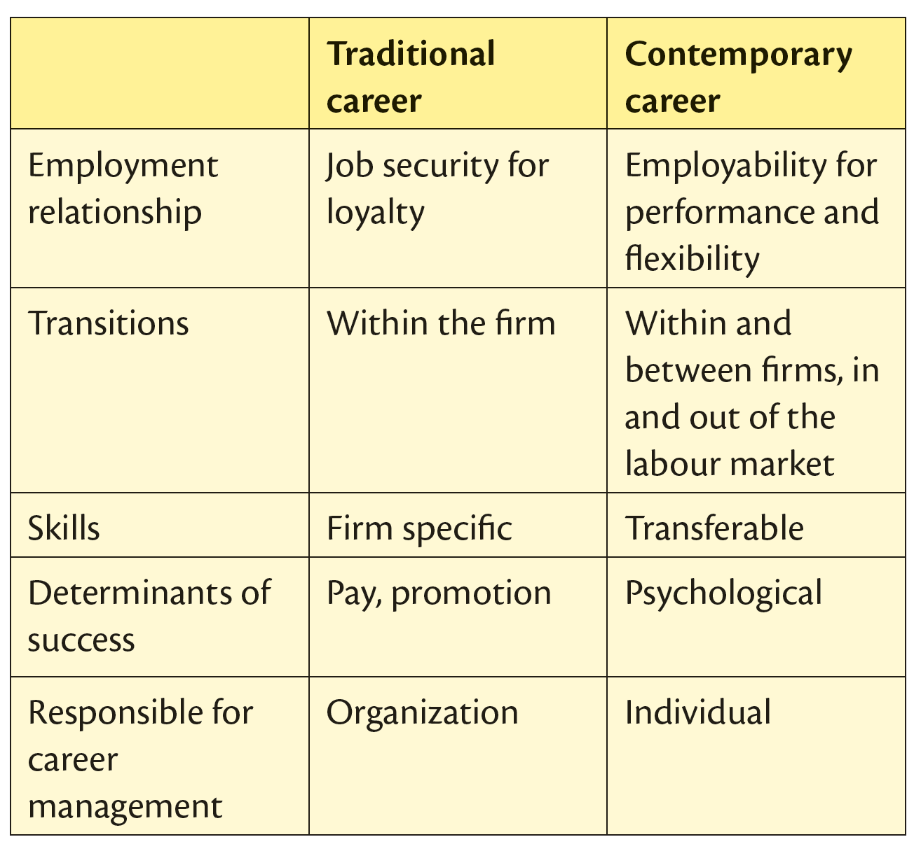
Comparison between Traditional Careers and Contemporary Careers

Slide 10
Graduate Employability, soft, hard and transferable skills
“Employability” work readiness – skills, knowledge, attitudes and commercial understanding contributing to organisational strategic decision making (Archer & Davision, 2008; Hamzah, et al., 2012).
Soft skills; responsibility, accountability, ethics, interpersonal skills, teamwork, decision making, analytical skills, creativity and critical thinking.
Hard skills; written communication, time management, IT skills, project management, presentation, ability to assimilate new technologies, computer skills and global/international business skills (Shuayto, 2013).

Slide 11
Transferable Skills
Problem solving
Self-management
Knowledge of the business
Literacy and numeracy relevant to the post
ICT knowledge
Good interpersonal and communication skills
The ability to use own initiative but also to follow instructions
Leadership skills (where necessary)
Teamwork
Lowden et al. (2011)
Notes:
Lowden et al. (2011), these key transferable or generic skills identified when recruiting newly qualified graduates include:

Slide 12
Graduate skills: Factors most important to Employers
Personal attitude, employability skills, relevant work experience and degree result.
The most important transferable skills to employers when recruiting graduates were; trustworthiness, reliability, motivation, communication skills and a willingness to learn (McMurray, et al. , 2016).
US employers of both business schools and graduates; an inability to transfer and apply knowledge content to ‘real life situations’’ in a fast-changing and dynamic global business environment (Shuayto, 2013).

Slide 13
Graduate skills
Four specific resources university graduates should possess: 1. Intellectual, 2. Personality, 3. Meta-skill and 4. Job-specific.
“Integrated Dynamic Capabilities”; crucial for enhancing the value of these individual resources.
Pre-graduate application and Personal narratives necessary to marshal individual resources in a complementary and strategic manner, in “real-world settings”.
Finch, et al, (2016)
Notes:
Pre-graduate application
Personal narratives necessary to marshal individual resources in a complementary and strategic manner, in real-world settings.

Slide 14
Graduate skills
17 employability factors can be clustered into five higher-order composite categories.
1. Soft-skills, 2. Problem-solving skills, 3. Functional skills, 4. Pre-graduate experience and 5. Academic reputation.
When hiring new graduates, employers place the highest importance on soft-skills and the lowest importance on academic reputation.
Finch, et al, (2013)
Notes:
Results from both the qualitative and quantitative phases of the current study demonstrated that 17 employability factors can be clustered into five higher-order composite categories.

Slide 15
17 skills in order of importance
1. Listening skills Soft-skills
2. Interpersonal skills Soft-skills
3. Verbal communication skills Soft-skills
4. Critical thinking skills Problem-solving skills
5. Professionalism Soft-skills
6. Written communication skills Soft-skills
7. Creative thinking skills Problem-solving skills
8. Adaptability Problem-solving skills
9. Professional confidence Pre-graduate experience

Slide 16
10. Job-specific competencies Functional skills
11. Leadership skills Problem-solving skills
12. Work experience Pre-graduate experience
13. Job-specific technical skills Functional skills
14. Academic performance Academic reputation
15. Programme reputation Academic reputation
16. Knowledge of software Functional skills
17. Institutional reputation Academic reputation

Slide 17
Contemporary Careers
Current careers tend to be dynamic, less predictable, and boundaryless (Lips-Wiersma and Hall, 2007)
It is the individual who bears primary responsibility for the planning and managing of their own careers
Career Concepts:
  Boundaryless
  Protean
  Authentic
  Kaleidoscope
  Off-Ramp Careers

Slide 18
Boundaryless Careers
Widening the perspective of careers to incorporate a range of possible careers both within and across organisations.
Careers are not tied to a sole employer, nor represented by an orderly sequence of hierarchical upwards movement as proposed by Super (1953) and are characterised by less vertical coordination and stability.
Boundaryless careers are not confined to physical changes of employment, the notion also applies to movement across psychological boundaries.
Career development requires the strengthening of self-direction and adaptability within a more transactional employment relationship.
Notes:
Stereotypical Silicon Valley career, moves across the boundaries of separate employers – IT professionals.

Slide 19
Protean Careers
The protean career offers a self-directed approach to career that is driven by the values of the individual (Briscoe and Hall, 2002)
Protean indicates something that is versatile, variable and capable of taking many forms
A person pursuing a protean career moves quickly to improvise new ways of working, making the most of the empowerment it provides them
Acts as a compass in providing direction (Hall, 2002) for an individual
  Understanding who they are and knowing their values, needs, goals and interests
Notes:
The Protean Career is a concept that requires everyone to 1) monitor and assess the job market; 2) anticipate future developments, trends, and industry shifts, 3) gain the necessary skills, qualifications, relationships, and assets to meet the shifts, and 4) adapt quickly to thrive in an ever-changing workplace.
Proteus, in Greek mythology, the prophetic old man of the sea and shepherd of the sea's flocks (e.g., seals). He was subject to the sea god Poseidon, and his dwelling place was either the island of Pharos, near the mouth of the Nile River, or the island of Carpathus, between Crete and Rhodes.
The Protean Career is a concept that requires everyone to 1) monitor and assess the job market; 2) anticipate future developments, trends, and industry shifts, 3) gain the necessary skills, qualifications, relationships, and assets to meet the shifts, and 4) adapt quickly to thrive in an ever-changing workplace.
First, I think you should conceptualize protean, boundaryless and traditional careers not as individuals' traits and types but more as social and career trends which are determined by various financial, psychological and social conditions and the forms the work organization takes from the period of industrialism to the one of postmodernism.
Entrepreneurial and Intrapreneurial focused employees.
Proctor and Gamble - "Huge investment in people development. Great variety of assignments, products, geographies. Great values — you are treated right." —
Deloitte - "Opportunities to lead teams very early in your career. Ever-changing environment so flexibility is a must!" — Deloitte Employee (San Francisco, CA).
Ernst & Young -"Great place to start your career. Organized training program and onboarding process. The company talks the talk and walks the walk when it comes to people first culture with flexibility and mobility." — Ernst & Young Employee (Chicago, IL)
PwC - "If you like variety, PwC is the place to be. You have a great number of opportunities in both audit and advisory roles, and if you challenge yourself, you can grow your career here." — PwC Audit Associate (San Jose, CA)
Boston Consulting group - "Very strong training program: analytics, presenting, slide writing, managing client relationships. Consistent, 360 feedback culture. Typical 2-year track to move to next level." —Boston Consulting Group Principal (location n/a)
The 25 Best Companies To Work For If You Want To Get Promoted Fast, Vivian Giang Oct. 6, 2013, Business Insider.

Slide 20
Protean Careers
Hall (2004) identified two competencies that help individuals become more protean. These are adaptability and/or self-awareness.
  Self-awareness and understanding are pivotal to the values-driven nature of a protean career, ensuring a secure personal base in which to foster career success and from which to interact with the changing external conditions.
  Adaptability involves the capacity to change career and work behaviours in a way that allows the individual to succeed in a number of contexts with the need for externally-driven career development.

Slide 21
Authentic Careers
The authentic career concept defines an authentic individual as one who makes career choices that are consistent with the past or with an imagined future about who they would like to become.
The key characteristic is that there is a consistent set of beliefs guiding the career.
Being truthful in authentic terms relates to the notion of consistency between how a person expresses themselves in public and what they feel in private.
An authentic career-oriented individual is one willing to take the initiative and responsibility for their career and able to achieve consistency between past and present, and private and public expressions of themselves (Svejenova, 2005).
Notes:
Own values – family business, sole trader, Politics, Public Service, Army, Medical, Charity, Writing etc.

Slide 22
Kaleidoscope Careers
A kaleidoscope career is created and evolved on the individual’s own terms, defined by their own values, life choices and parameters, rather than by the organisation (Mainiero and Sullivan, 2006).
This particular concept is predominantly female-oriented in focus.
Individuals amend, adjust and modify this kaleidoscope or career pattern, by rotating the various aspects of their lives to arrange roles and relationships in new ways.
Individuals strive for challenging work that facilitates career advancement and increases self-worth.
A need for balance exists with regard to work, relationships and personal concerns.
Notes:
Life style and life stages. Work life balance, family friendly, career counselling, gender balance, Sweden.

Slide 23
Kaleidoscope Careers
Mainiero and Sullivan (2006) found that men and women tend to follow different career patterns:
  Women tend to focus on challenge in early career, with balance becoming more important in mid-career, and authenticity becoming the primary focus in late career.
  Men, on the other hand, focus on challenge in early career, to authenticity in mid-career, to balance in late career.

Slide 24
Off-Ramp Careers
A predominantly gender-specific career concept has emerged in recent years in response to the “male competitive model” of careers (Hewlett, 2007).
The male competitive model of careers supported a preference for a continuous employment history, which penalised women who needed to take time out of their careers.
The idea of off-ramp careers provide an arc of career flexibility that allows women to “ramp-down” or take time off from their career and subsequently “ramp-up” or re-enter the labour market without losing career traction.
The difficulty women face is at the moment they decide to return to employment, be it for financial, sense of identity or satisfaction reasons.

Slide 25
Off-Ramp Careers
Facilitating ease of access in returning to careers has led to organisations introducing a variety of career flexibility and flexible working arrangements in terms of:
  Reduced-hour options
  Flexible working times
  Job sharing
  Telecommuting
  Seasonal flexibility
Off-ramping from a male managerial perspective is concerned with strategic repositioning of his career rather than for family-related concerns.
Notes:
IKEA/ GMS?

Slide 26
Portfolio Careers
Rather than pursuing a single full-time job, the individual balances a portfolio of different and changing employment opportunities (Handy,1989).
Individuals build careers around a collection of skills and interests and place a strong emphasis on self-management.
Portfolio-centred career development is based on a very different set of assumptions regarding the nature of careers and of the relationship between the organisation and the employee.
  The contract output is identified
  Matching portfolio of skills needed to complete the contract is specified
  Individuals with those skills are located in the HR information system
  The contract is offered and then managed
Notes:
Contracts – multiple clients.
Consultant – teaching and practice. Mediation. Counselling.
Vendor.

Slide 27
Portfolio Careers
The shift in assumptions requires a different emphasis in the traditional roles and responsibilities of HRM in the organisation.
Career development professionals will need to recognise some significant differences in the organisational and individual needs of different types of organisations and employees.
Serious consideration must be given to determining what aspects of the firm’s activities could be contracted out or dealt with on a contract basis.
It concentrates on understanding the skill requirements needed to accomplish the contract.
It focuses on locating individuals with the precise skill sets needed for accomplishing that task or contract.
Learning and development become the individual’s responsibility.
Notes:
Mgt Consultant.
Books and talks.
Govt
Public and Private.

Slide 28
Core theme of Career Management
Context
Patricia McLagan (1989) argues that career development is the alignment of individual career planning and organising career-management processes to achieve optimal match between individual and career needs.

Slide 29
Career anchors
Schein (1978) argues that an individuals’ career and career choices are governed by a number of career anchors which are their own self-perceived talents, abilities, skills, competencies, attitudes and values.
These are as follows;
  Technical functional competence: functional skills that can be applied to a variety of settings e.g. admin, computer skills, presentation skills etc.
  Managerial competence: analytical, interpersonal and emotional.
  Security and stability: financial security.

Slide 30
Creativity: create new things e.g. products, businesses or services.
Autonomy and independence: career is organised around the search for an occupation such as writing or consultancy which allows the individual to determine work hours or life style.
Highlights individual ‘internal’ career anchors and ‘external’ careers: these match each other.

Slide 31
Miller and Rice (1967) career development has been predicated on the notion that the most successful individuals with in an organisation are directed towards a managerial career.
They look at the irony that those who are the most successful sales people, doctors, lecturers, nurses, researchers get promoted to a position were they do not get to use the very skills that made them so successful.
The skills they have earned so far will turn out to be a disadvantage in the long run.
This is often referred to as ‘The Peter Principle’, that is been promoted to the level of ones own incompetence.

Slide 32
Tournament notion of a career
Rosenbaum (1984) Tournament is used to judge individuals career potential.
Employee needs to win in the early stages in order to remain in the game.
  In Japan (Nissan) this consists a qualification from one of the top universities to get into an elite cadre.
  This is followed by a number of years of training, job rotation and socialisation until their early 30s.
  The individuals deemed to have the highest potential are given swift promotion and their peers are encouraged to leave the company.
  In a case of limited positions people will jockey for position.

Slide 33
Traditional notion of career
Traditional succession was spelled out by clear-cut hierarchies within organisations with a clear career path to follow. These were offered to those who were viewed as having potential within the organisation.
Succession planning
This is uncommon but it involves naming an individual who will be replacing another one further up within the organisation when they retire or leave.
Targeted development
Companies fill management openings with individuals identified and prepared as candidates for one or more specific management positions.
Notes:
Succession plan – IBM. The who, when, why, where and how of career development.

Slide 34
Career path analysis
Rothwell and Kazanas (1989) suggest that there are two types of organisationally constructed career paths;
  Formal: made explicit by the organisation
  Informal: made explicit by examining historical movement of employees

Slide 35
Career analysis looks at what career paths individuals should follow while working within the organisation. This involves two approaches:
  Prescriptive: detailing logical relationships between jobs and logically related knowledge and skills necessary to qualify for movement from one job to the next.
  Descriptive: detailing historical experiences of individuals who have been moved through the ranks over time e.g. manpower system/manpower planning.

Slide 36
Career and lifespan development
People are now having to take a more active interest in their own career development
Fewer organisations offer job for life
Downsizing and delayering
Greater emphasis on employees taking responsibility for their learning and development

Slide 37
Career Management
‘Employees learn and develop through carrying out their jobs…the design of those jobs and the organisation structure, the degree to which it is centralised and bureaucratised, all influence employees’ learning opportunities’
People need to grow in their jobs, and might outgrow their jobs as they learn, or to move into new jobs that would allow them to continue the process of their development.’
(Beardwell & Claydon: 2007:290)

Slide 38

Career Management
The term infers that there is a formal planned approach to managing an individuals or groups of individual’s careers
The style of the organisation, the lifestage of a company (growth vs decline) may influence the approach to career management
The culture of the organisation will also be a significant influence
The individuals aspirations

Slide 39
Company Strategy
Business Model
People Model
Strategy
Performance
Current Role
Future Roles
Aspirations of individual

Slide 40

Career Management and Development
The concept of a career has evolved over time
The expectations from a job vs a career are now very different
The expectations from employers has significantly changed
The expectations from employees has also significantly changed

Slide 41
Models
Taylor’s transitional model – argues that the systematic training model could be improved if it were embedded in a map of the wider corporate strategic context
Systems Model – takes account of limitations of organisation reality that means that training activity is at a low level in the organisation with little buy in from managers
(Garavan:1997:323)

Slide 42
Ashbridge Model
Training and development is seen as continuous by individuals and crucial for the future survival of the organisation
Links to company strategy and vision
Seen as a source of competitive advantage
Self-selection for training is encouraged
Range of training interventions available
Main responsibility rests with line managers
There is tolerance of failure as part of learning
(Garavan:1997:324)

Slide 43
Career Development
‘Individual development interacts with the organisation and its development through the individual’s career. Career development therefore is of significance for both individual and organisation, and hence for human resource development’.
(Beardwell and Claydon 2007:283)

Slide 44
Career Management a Central Concern for the Employment Relationship, Nicholson and Arnold, 1989
Restricted | While some restrictions are inevitable, organisations can often create unnecessary ones such as non-promotional transfers between functions.
Political | Where career opportunities can be blocked by managers who perhaps seek to advance their own interests at the expense of individual employees.
Mechanistic | Where career moves are controlled by rules and procedures that do not allow for exceptions and fail to take account of changing circumstances.
Neglected | Where possible career paths are simply not identified and no one can see the way forward.

Slide 45
Career Development Techniques, Gunnigle, Heraty and Morley, 2011
Succession Planning | Employees deemed suitable for key positions in the future are identified and ‘earmarked’. They are then provided with the necessary experiences, training to enable them to take up these positions.
Career counselling | The organisation appoints and external counsellor (perhaps an internal manager may consider this role) to assist individual employees to clarify their ideas about self and work. Psychometric tests are often used to identify career opportunities for individual employees.
Skills Inventories | The organisation develops detailed records on the skills, experiences, qualifications and expertise accumulated by each employee, coupled with information on individuals’ career preferences and objectives.
Mentoring Programmes | Organisation develops systems whereby older, more experienced workers act as role models for younger employees – they support, guide and counsel the employee through their time within the organisation.
Educational Opportunities | The organisation overtly promotes continuous development and provides information and financial support on both internal and external courses/training/conferences.

